Slide 1
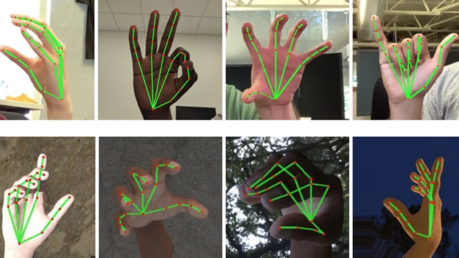
SignScribe
An AI Powered Real Time Sign Language Translator Platform
AI Brawlers
Bryan Tang: Research and Design
Davis Wang: Software Development
Nemo Kim: Hardware Implementation
AI Brawlers

Slide 2
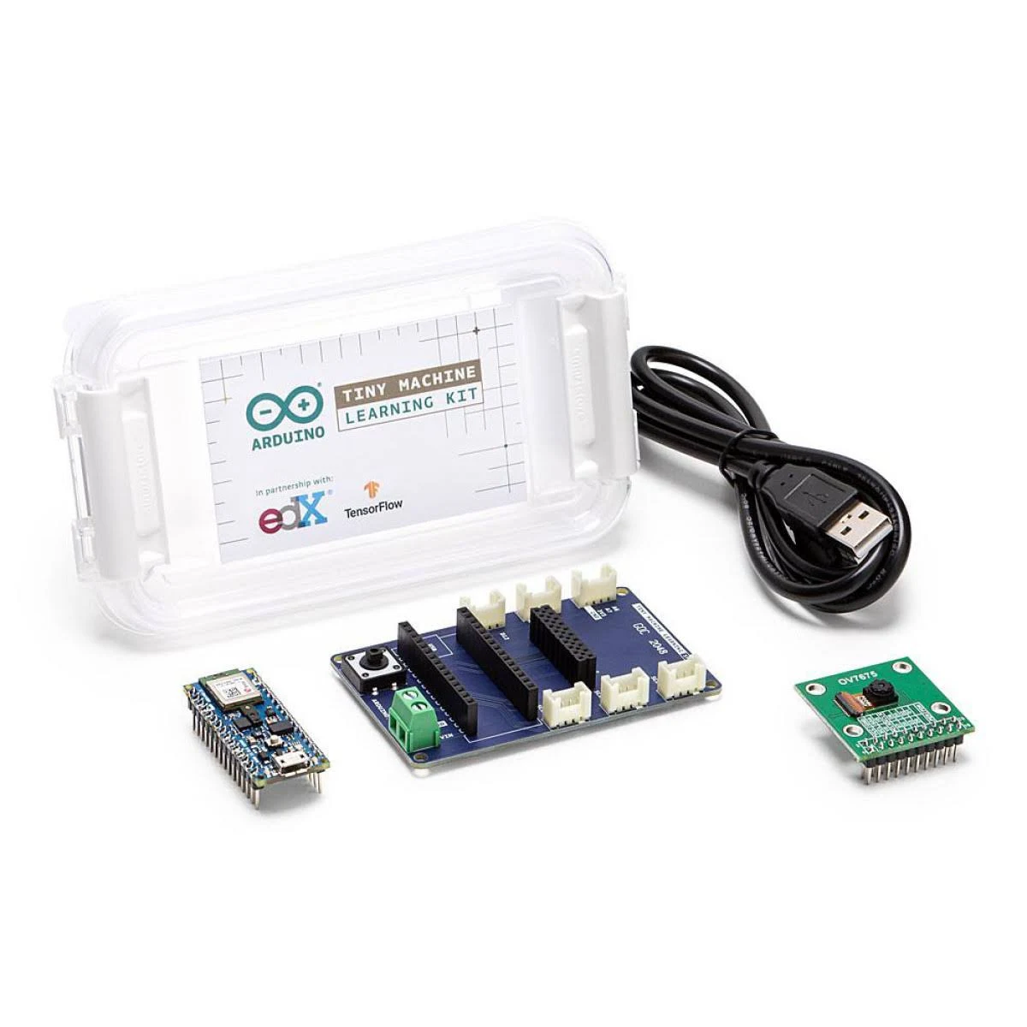
Platform: Arduino TinyML Kit, Arduino Nano 33 BLE; Camera; Tensorflow #2
Objectives
Develop a Real-Time Gesture Recognition Model: Train and deploy a deep learning model on the Arduino TinyML kit that accurately recognizes sign language gestures in real time.
Achieve High Accuracy and Responsiveness: Optimize the model to ensure reliable classification of various hand gestures with minimal delay, aiming for high throughput and low latency.
AI Brawlers

Slide 3

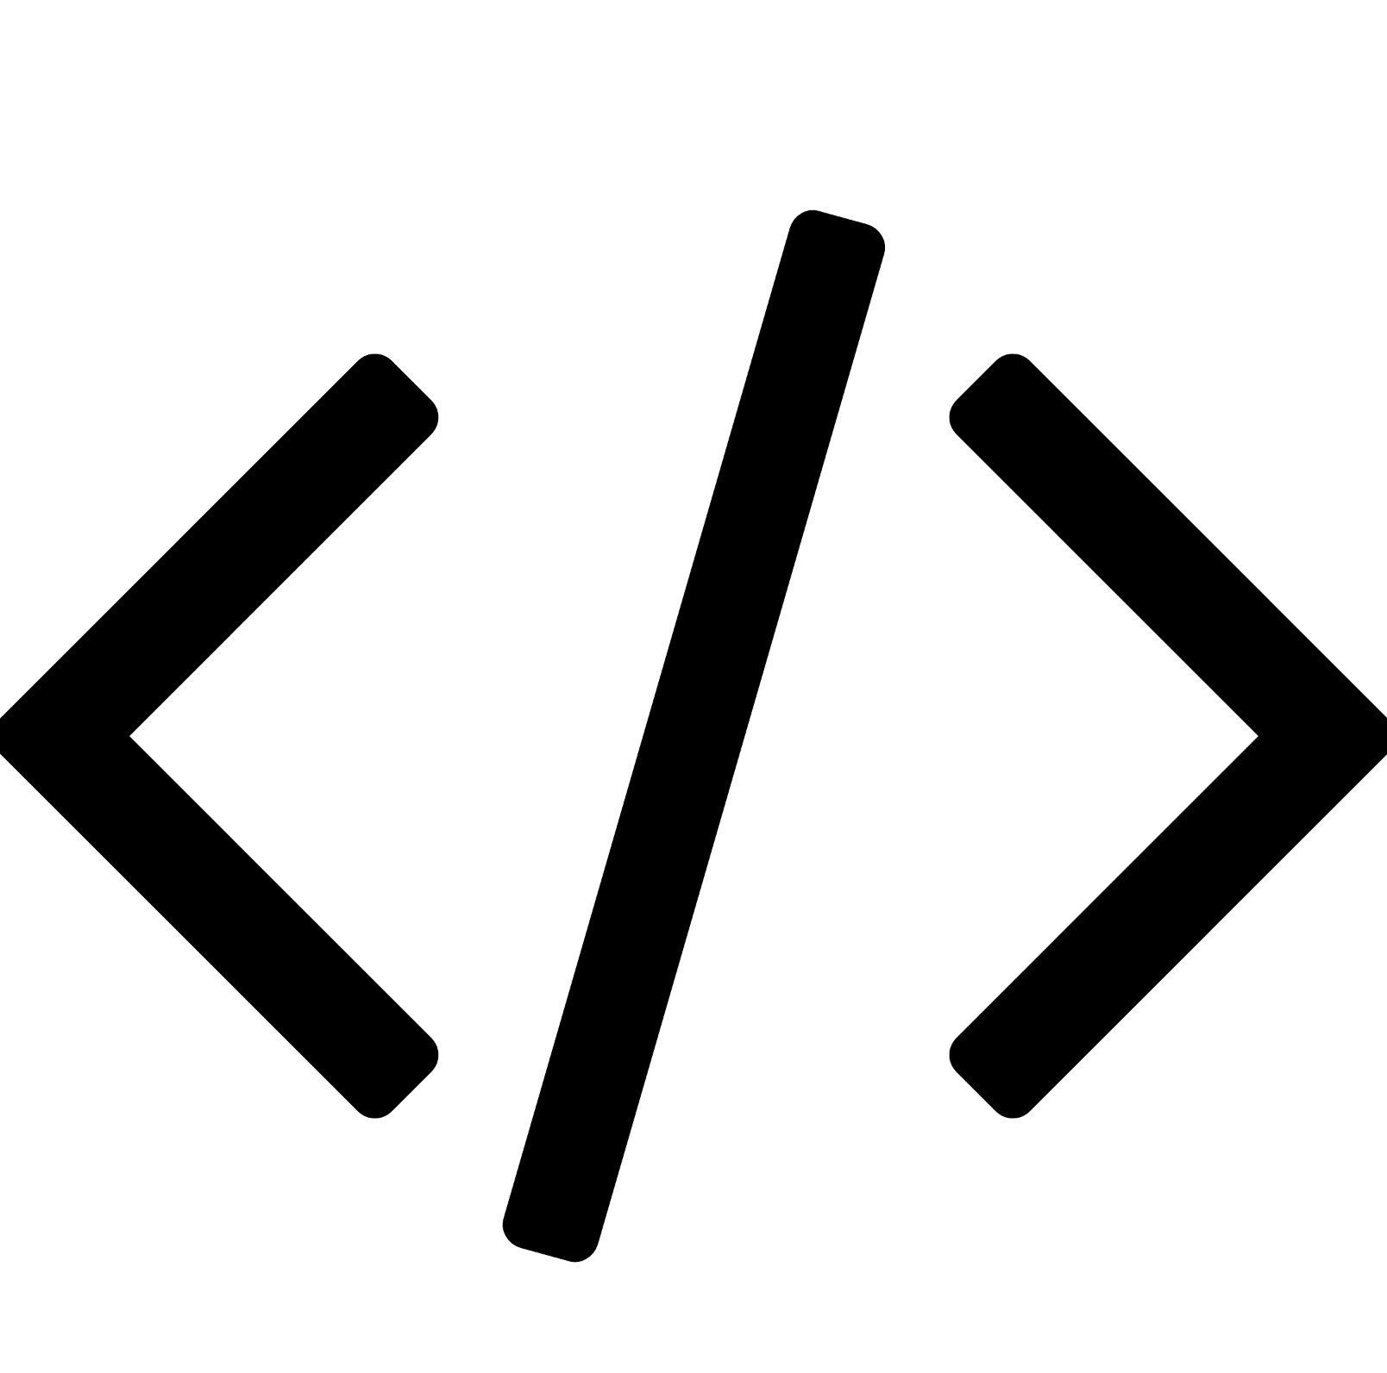


Applications:
Real time communication for educational purposes
Assistive Technology for Healthcare Providers
Language Learning Tool
Timeline - 4 weeks
Week 1
Week 2
Week 3
Week 4
Research
Software Development
Hardware Implementation
Testing
AI Brawlers

